Slide 1
FINTECH MDM DATA SCIENCE
HEALTHCARE ANALYTICS DOMAIN
Primary Target: 30-Day Readmission
Chronic Disease Management Analytics: Diabetes
Data Cleaning • Feature Extraction • Outcome Analysis • Input–Output Framework
PROBLEM STATEMENT
"Analysis of chronic disease management trends to identify factors associated with poor disease management and support improved patient monitoring and healthcare outcomes."
PROJECT TEAM
23610074
Aaditya Shirke
23610067
Aditi Mittal
23510076
Arth Rai
23610078
Avinash Waykule
23510038
Pranav Gujar

Slide 2
RESEARCH SCOPE & OBJECTIVES
What Are We Trying to Understand?
Beyond Simple Prediction
Core Research Question
Operational Target
Shift focus from diagnosis prediction toward understanding post-discharge outpatient instability and acute relapse patterns.
Which patient baseline metrics, clinical regimens, and historical visit patterns correlate most strongly with acute care relapses?
30-day hospital readmission serves as the primary quantifiable healthcare proxy for chronic disease management failure.
END-TO-END ANALYTICAL JOURNEY
Patient Baseline
Clinical Regimen
Care Patterns
30-Day Readmission
Targeted Protocols
Demographics & Vitals
Meds & Diagnoses
Past Utilization
Primary Failure Proxy
Clinical Action

Slide 3
EVIDENCE BASE SELECTION
Evaluating Our Data Sources
Dataset | Core Strengths | Key Limitations | Project Role
🥇 UCI Diabetes 130-US | 101,766 encounters, 47 features, real readmission outcomes. | Lacks direct lifestyle habits (diet, step counts). | PRIMARY DATASET
🥈 CDC NHANES | Rich lifestyle, nutrition, and socioeconomic metrics. | Cross-sectional; no longitudinal readmission tracking. | Contextual Support
🥉 MIMIC-IV | Granular ICU records with timestamped events. | Excessive multi-table relational complexity. | Enterprise Reference
4️⃣ Kaggle Diabetes | Pre-packaged adherence and checkup frequency fields. | Synthetic data; cannot serve as real-world evidence. | Conceptual Reference
Selection Decision: UCI 130-US is selected as the primary modeling foundation due to its verified hospital readmission outcome labels and multi-facility clinical diversity.

Slide 4
DATA ARCHITECTURE
Primary Dataset Structure & Variable Inventory
101,766
130
50
47
Hospital Encounters
US Hospitals
Total Columns
Clinical Variables
Demographics
Diagnostics
Medications
Utilization
12 Variables
9 Variables
22 Variables
4 Variables
patient_nbr, encounter_id, age, gender, race, admission/discharge IDs, time_in_hospital, payer_code, weight.
diag_1, diag_2, diag_3 (ICD-9 codes), num_lab_procedures, num_procedures, number_diagnoses, A1Cresult, max_glu_serum.
num_medications, 23 specific diabetes drug therapies (insulin, metformin, glipizide), and dosage change flags.
Past outpatient, inpatient, and emergency visit counts; 30-day readmission status (NO, >30, <30).

Slide 5
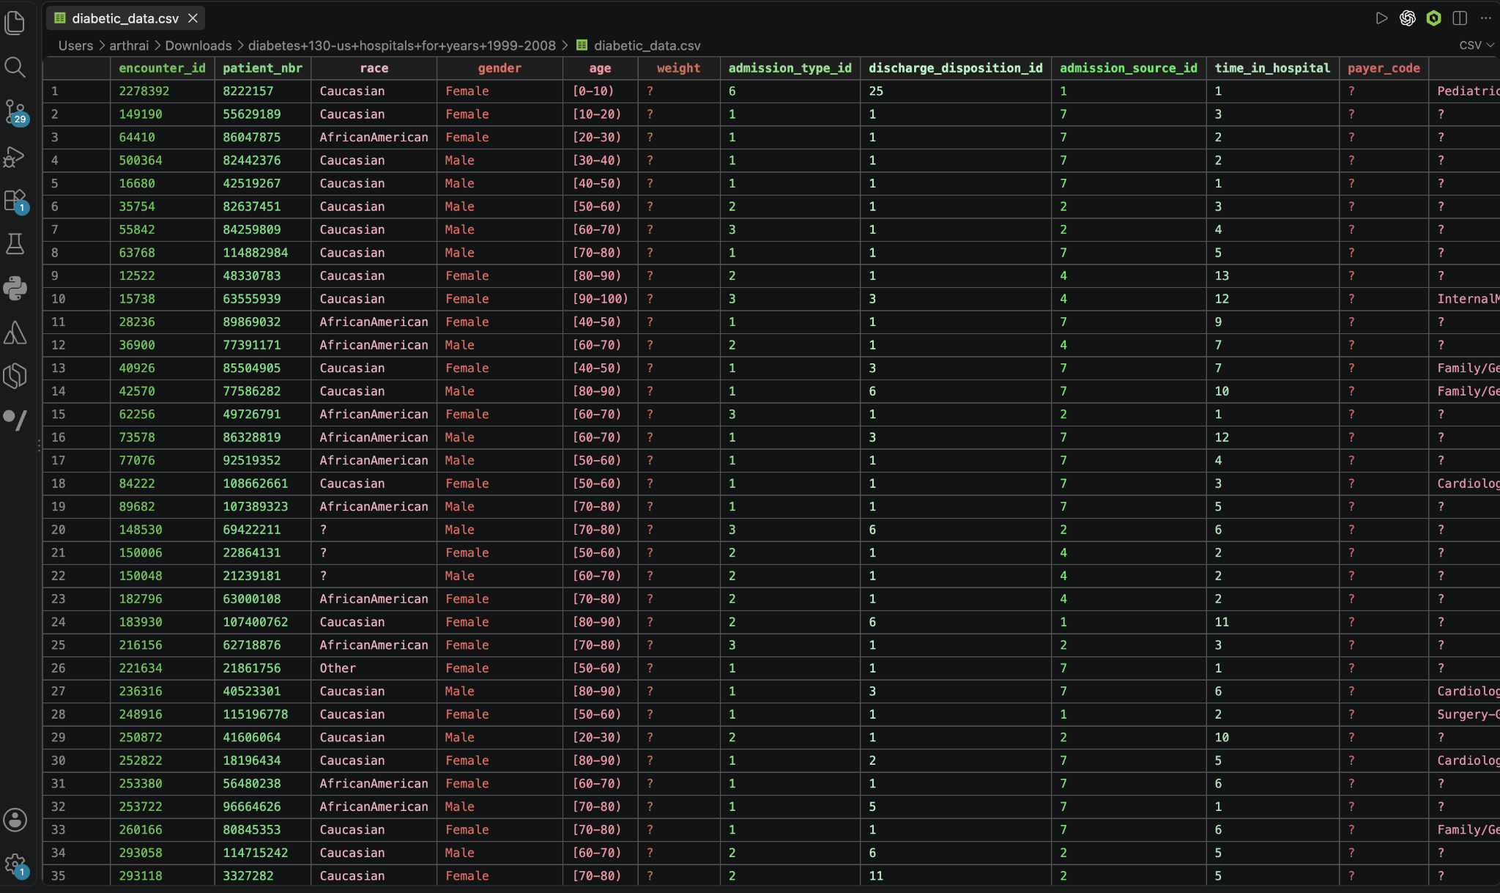

Slide 6
DATA INTEGRITY
Data Cleaning — Missingness & Data Quality Audit
Severe Missingness (Explicit "?" Tokens)
Minor Missingness Imputation
race (2.23%) and diagnosis codes diag_1 (0.02%), diag_2 (0.35%), diag_3 (1.40%): Imputed with modal classes or grouped into "Unknown/Other".
weight
96.86% Missing
Dropped completely; prevents extreme imputation bias.
medical_specialty
49.08% Missing
Retained as explicit "Missing/General Doctor" category.
100% Complete Clinical Fields (0% Missing)
• Demographics: Age, gender
payer_code
39.56% Missing
• Clinical Load: Medication counts, lab procedures, stay length
Preserved as "Unknown" socioeconomic proxy.
• Utilization History: Prior outpatient, emergency, inpatient visits
• Target Variable: 30-day readmission status complete across all records

Slide 7
OPERATIONAL PROTOCOLS
Data Cleaning Strategy & Operational Rules
Data Quality Issue | Observed Pattern | Treatment Executed
Missing Markers | Missing values stored as "?" string tokens. | Converted to standard nulls; encoded as explicit "Unknown" categories.
Hospice / Expired | Discharge codes for expired patients or hospice care (2,423 encounters). | Excluded from cohort; patients ineligible for readmission (Cohort: 99,343).
Repeated Patients | Multiple encounter_id entries under a single patient_nbr. | Retained: Chronic disease analytics requires studying cumulative hospital reliance.
Utilization Outliers | Heavy right skew in acute care visits (number_emergency > 30). | Retained: Captures authentic high-risk behavior rather than noise.
Type Encoding | Administrative IDs stored as integers (admission_type_id). | Converted to explicit categorical factors to prevent artificial numeric ordinality.
Analytics Principle: Patient exclusions are restricted strictly to non-eligible discharge codes (hospice/expired) to preserve clinical validity while maintaining authentic real-world outlier distributions.

Slide 8
ANALYTICAL ENGINEERING
Feature Extraction Pipeline
1. Binary 30-Day Readmission (readmitted_30d)
3. Polypharmacy Index (Binned Complexity)
readmitted_30d = 1 if readmitted == "<30" else 0
Low (0–5 meds)
Moderate (6–14)
High (15+ meds)
4,938 enc (7.61%)
43,526 enc (10.28%)
50,879 enc (12.70%)
Establishes the primary acute care relapse target (11,314 positive cases, 11.39% baseline rate).
4. ICD-9 Clusters & Titration Indicator
2. Prior Healthcare Utilization Index
• ICD-9 Mapping: High-cardinality diag_1 mapped to 4 clusters: Circulatory/Heart, Direct Diabetes, Respiratory, Other.
• medication_changed: Binary flag isolating whether any diabetes drug dosage was altered during inpatient stay.
total_previous_visits = number_outpatient + number_inpatient + number_emergency
Aggregates past acute reliance into one composite metric of patient healthcare system dependence.

Slide 9
THEORETICAL MODEL
The Core Framework: Input → Channel → Output
STAGE 1
Observable Inputs
STAGE 2
Analytical Channel
STAGE 3
Healthcare Output
Patient & Clinical Baseline
Connecting Mechanism
Measurable Endpoint
• Demographics: Age bracket, gender, race
Disease Management & Care Utilization Patterns
30-Day Readmission
• Clinical Status: Diagnoses clusters, lab procedures, stay length
Evaluates how well the condition is stabilized in outpatient ambulatory settings versus acute emergency/inpatient over-reliance.
Y ∈ {0, 1}
• Medication Regimen: Drug count, insulin therapy, dose adjustments
Indicates post-discharge chronic management failure and acute clinical relapse.
• Prior Utilization: Past emergency, outpatient, and inpatient stays
Goal: Translate observable input anomalies into early warning signals that identify failure within the care channel before acute readmission occurs.

Slide 10
HYPOTHESIS FORMULATION
Candidate Explanatory Variables
Dimension | Variables Examined | Research Question
Demographic | age, gender, race | Do readmission rates differ significantly across age brackets and demographic cohorts?
Clinical | diag_1 clusters, number_diagnoses, time_in_hospital, A1Cresult | Does comorbidity burden or stay duration correlate with higher readmission risk?
Treatment | num_medications, insulin, medication_changed | Does polypharmacy or active medication alteration reflect clinical instability?
Utilization | number_inpatient, number_emergency, total_previous_visits | Does frequent prior hospital utilization act as a leading indicator of relapse?
Methodological Stance: Hypotheses evaluate statistical associations and risk stratification power while explicitly controlling for confounding variables in multivariable regression.

Slide 11
VERIFICATION PIPELINE
Statistical Testing Roadmap
STEP 01
STEP 02
STEP 03
STEP 04
STEP 05
Descriptive Baseline
Bivariate Stratification
Hypothesis Testing
Multivariable Logit
Clinical Translation
Summarize distribution metrics (mean, median, IQR) and confirm 11.39% readmission cohort baseline.
Contrast readmission rates directly across candidate factors (visit counts, polypharmacy tiers).
Pearson’s Chi-Square (χ²) for categorical traits; non-parametric Mann–Whitney U for skewed counts.
Fit adjusted models to compute Odds Ratios (aOR) with 95% CIs while controlling for clinical confounders.
Convert statistically significant odds ratios into actionable risk tiers and discharge protocols.
Significance Threshold: All tests evaluated at significance level α = 0.05. Non-parametric methods applied to avoid bias from heavily right-skewed acute care utilization distributions.

Slide 12
EMPIRICAL EVIDENCE
Exploratory Visuals & Key Observations
Prior Hospital Stays
Polypharmacy Load
Age & Stay Length
HbA1c & Titration
22.02%
12.70%
12.47%
p < 0.001
vs 8.59% (0 stays)
High (15+ meds)
Age 80+ bracket
χ² = 42.56
Patients with 2+ prior inpatient stays face over 2.5× higher readmission rate (p < 0.001).
High polypharmacy exhibits 12.70% rate vs 7.61% for low-regimen patients (χ² = 209.17, p < 0.001).
Geriatric patients show elevated readmission (χ² = 133.60, p < 0.001) with stay lengths of 3–6 days.
Significant association between A1C result and readmission outcomes across cohorts.
Takeaway: Strongest single relapse indicator.
Takeaway: Reflects frailty & dosing vulnerability.
Takeaway: Burden concentrates in multimorbid groups.
Takeaway: Active testing mitigates post-discharge risk.
All exploratory associations confirmed statistically significant at p < 0.001, motivating rigorous multivariable modeling to eliminate confounding effects.

Slide 13
STATISTICAL VALIDATION & MULTIVARIABLE MODELING
Empirical Findings & Multivariable Logistic Regression
Cohort: 99,343 Encounters
Readmissions: 11,314 (11.39%)
HYPOTHESIS TESTS (ALL P < 0.001):
Inpatient: MW U = 6.05×10⁸
ER Visits: MW U = 5.30×10⁸
Polypharmacy: χ² = 209.17
Insulin Status: χ² = 199.30
Age Groups: χ² = 133.60
Predictor Variable | Adjusted OR | 95% CI | p-value | Clinical Interpretation
Prior Inpatient Visits | 1.310 | 1.293–1.327 | <0.001 | +31.0% risk per prior admission; primary relapse predictor.
Prior Emergency Visits | 1.034 | 1.017–1.052 | <0.001 | Each prior ER visit increases adjusted odds by 3.4%.
Diagnosis Count | 1.048 | 1.035–1.060 | <0.001 | Comorbidity burden adds ~4.8% incremental risk per condition.
Length of Stay | 1.024 | 1.016–1.031 | <0.001 | Extended stay duration reflects acute clinical frailty.
Age 80+ (vs. 0–39) | 1.219 | 1.106–1.345 | <0.001 | Geriatric patients face 21.9% higher adjusted relapse odds.
Age 60–79 (vs. 0–39) | 1.138 | 1.039–1.247 | 0.006 | Older adult diabetic cohorts face 13.8% higher adjusted odds.
Medication Changed | 0.936 | 0.887–0.988 | 0.016 | 6.4% protective effect from active inpatient titration.
Multivariable Logistic Model (Logit Link)
McFadden Pseudo-R² = 0.0363
Dependent Variable: readmitted_30d

Slide 14
ACTIONABLE OUTCOMES
Translating Analytics into Healthcare Interventions
PRIORITY 1
PRIORITY 2
PRIORITY 3
Frequent Hospital Users
Complex Polypharmacy
Geriatric Comorbidity
EMPIRICAL SIGNAL
EMPIRICAL SIGNAL
EMPIRICAL SIGNAL
Prior inpatient aOR = 1.310 (+31% / visit). Readmission reaches 22.02% for ≥2 visits.
High polypharmacy (15+ meds) drives readmission to 12.70% (χ² = 209.17).
Age 80+ aOR = 1.219; diagnosis count aOR = 1.048 per co-occurring chronic condition.
INTERVENTION PROTOCOL
INTERVENTION PROTOCOL
Mandate discharge medication reconciliation with a clinical pharmacist to resolve adverse drug interactions and dosing errors.
INTERVENTION PROTOCOL
Assign dedicated case managers; mandate automated 48-hour post-discharge phone follow-ups and rapid outpatient check-ins.
Co-schedule multidisciplinary cardiology, nephrology, and endocrine outpatient reviews within 7 days of discharge.
Strategic Shift: Moves health system operations from reactive emergency readmission care to proactive, algorithmic chronic disease management.

Slide 15
MILESTONE REVIEW
Summary & Analytical Next Steps
Completed Milestones
Immediate Next Steps
Data Ingestion & Cohort Filter: Processed 101,766 raw records; removed 2,423 hospice/expired encounters to isolate an analytical cohort of 99,343.
Risk Scoring Matrix: Finalize a rule-based patient risk scoring matrix (Tier 1 High, Tier 2 Moderate, Tier 3 Low) based on empirical logit coefficients.
Feature Engineering: Constructed derived metrics (readmitted_30d, total_previous_visits, polypharmacy bins, ICD-9 clusters).
Decision-Support Workflows: Construct workflow mockups illustrating pharmacist reconciliation alerts and 48-hour outpatient outreach triggers.
Statistical Testing: Confirmed significant associations across age, polypharmacy, and utilization via Chi-Square and Mann–Whitney U tests (all p < 0.001).
Model Packaging & Calibration: Package final code, model calibration plots, ROC curves, and clinical translation recommendations for final delivery.
Multivariable Logit: Fitted logistic regression isolating prior inpatient visits (aOR = 1.310) as the leading independent risk factor.
Chronic Disease Management Study Group • FinTech MDM Data Science & Analytics

